Slide 1
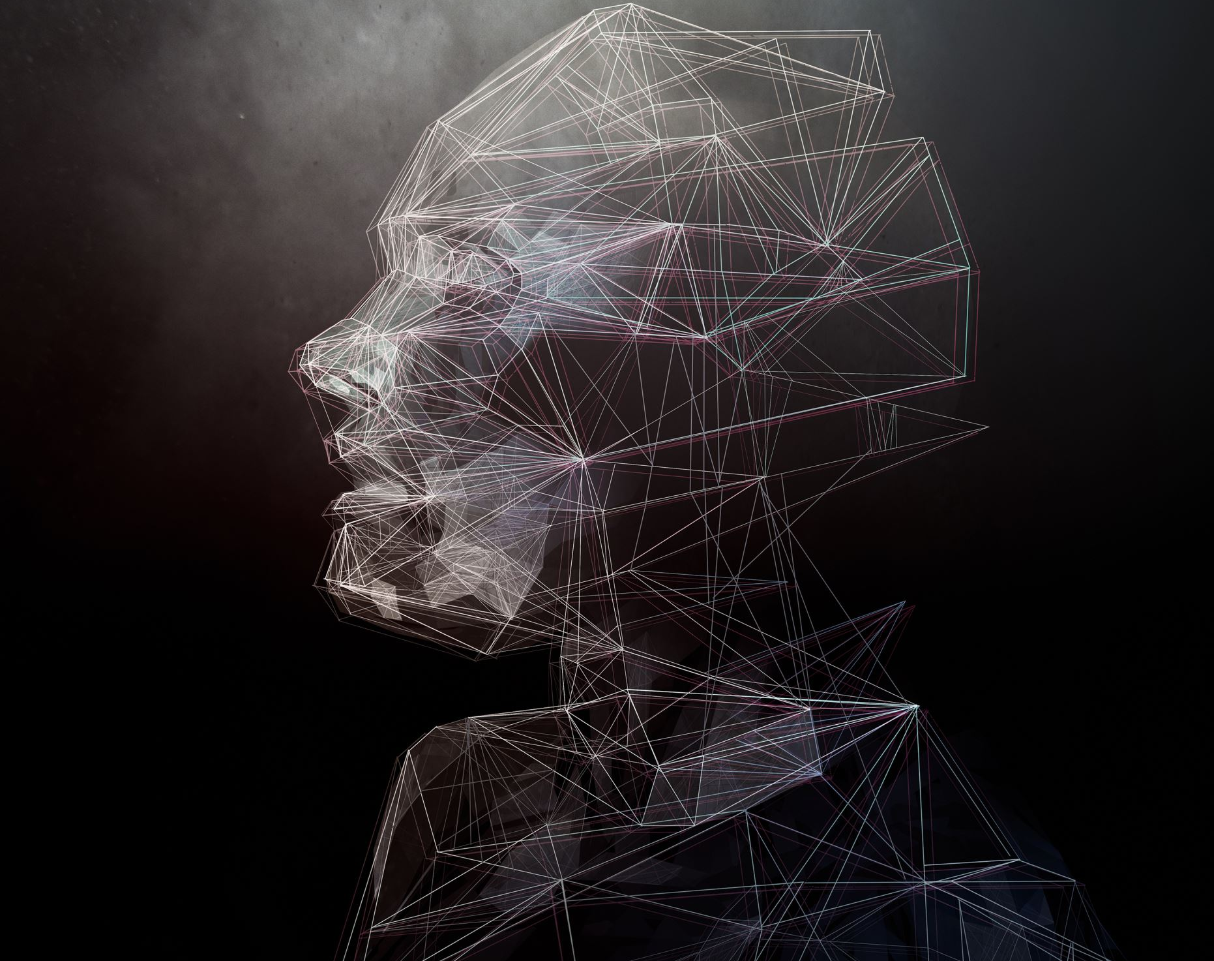

AI-Portrait classification
Supervisor:-
Ms. Shaveta Arora
By: -
Sahir Karigar (20CSU092)
Prateek Dhankar(20csu080)

Slide 2
INTRODUCTION
AI has transformed technology, allowing machines to perform tasks once thought exclusive to humans. One significant advancement is AI's ability to generate realistic portrait images .this raises concerns about authenticity and potential deception. These portraits can mislead viewers. It's essential to accurately distinguish between AI-generated and human-generated images.

Slide 3
Literature survey
GAN-generated Faces Detection: A Survey and New Perspectives" by Matern, Riess, and Stamminger
accuracy rates, often surpassing 95%
challenge posed by the continual improvement of GANs, which makes detection increasingly difficult
Detecting CNN-Generated Facial Images in Real-World Scenarios by Hulzebosch
achieving a notable result of 98%
inadequacy of sole reliance on human judgment for discerning AI-generated images in real-world scenarios

Slide 4
NEED OF AI GENERATED PORTRAIT
CLASSIFICATION
• Phishing
• Frauds
• Proper crediting

Slide 5
Proposed Technique
Convolutional neural network (CNN)
A convolutional neural network (CNN) is designed for processing visual data like
photos
Videos
CNNs are highly effective in computer vision tasks like Image classification

Slide 6
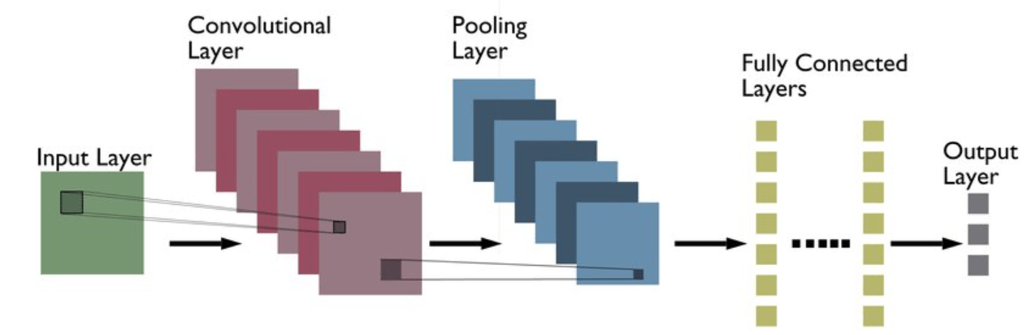
CNN

Slide 7
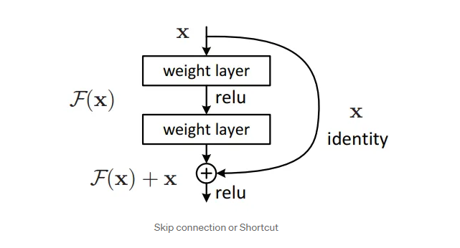
Resnet

Slide 8
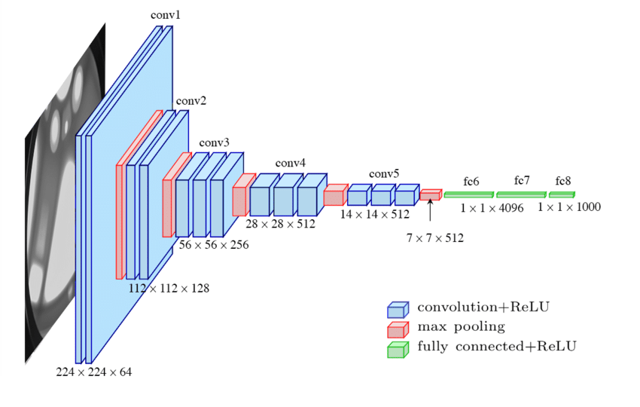
VGG

Slide 9
Challenges and Issues
Smaller data tend to overfit
Images from various sources is essential
Harder to fit bigger data as more memory required
Bigger data is computationally hungry requiring time
Resizing image may deteriorate the quality

Slide 10
Dataset
AI generated Portraits
https://www.kaggle.com/datasets/bwandowando/all-these-people-dont-exist
Real Portraits
https://www.kaggle.com/datasets/ashwingupta3012/human-faces?rvi=1
Combined
https://www.kaggle.com/datasets/philosopher0808/real-vs-ai-generated-faces-dataset/data?select=dataset

Slide 11
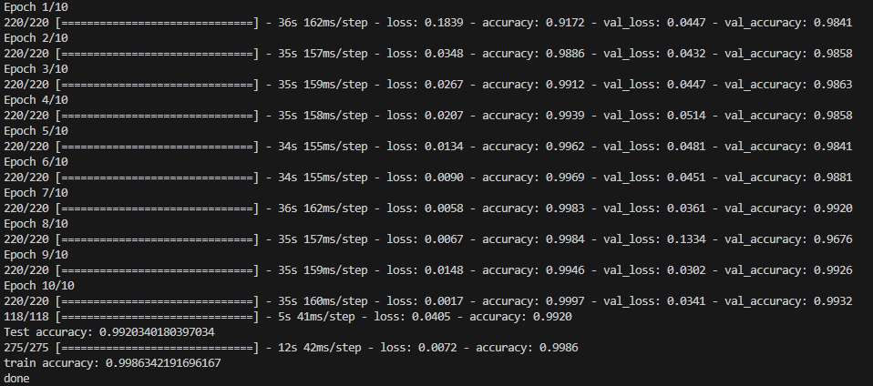
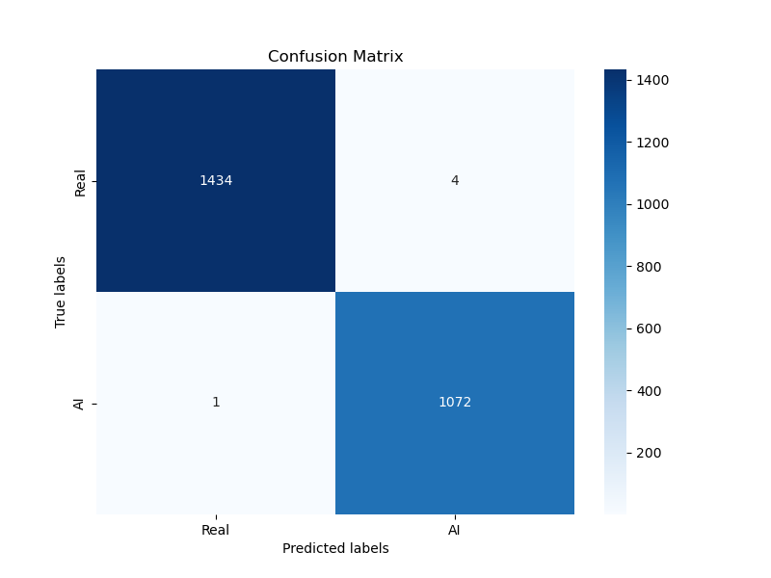
CNN

Slide 12
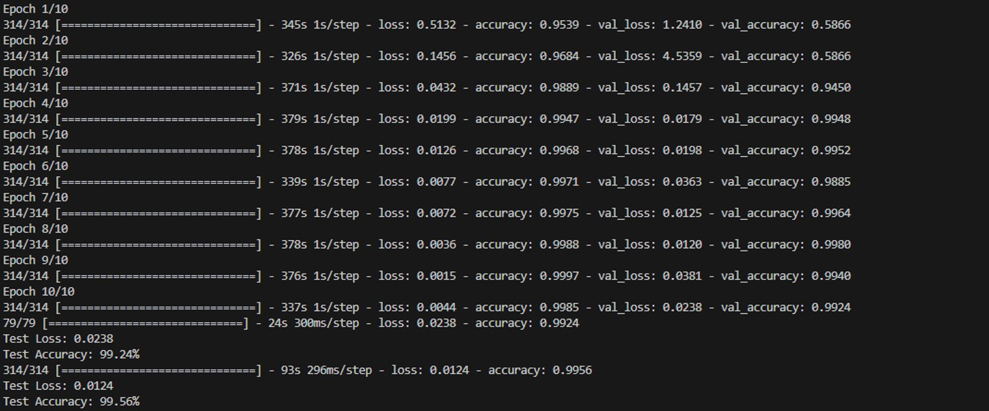

Resnet

Slide 13

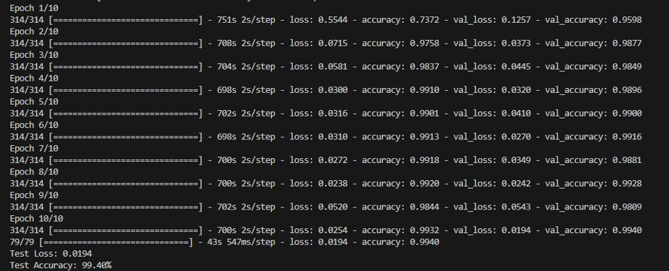
VGG

Slide 14
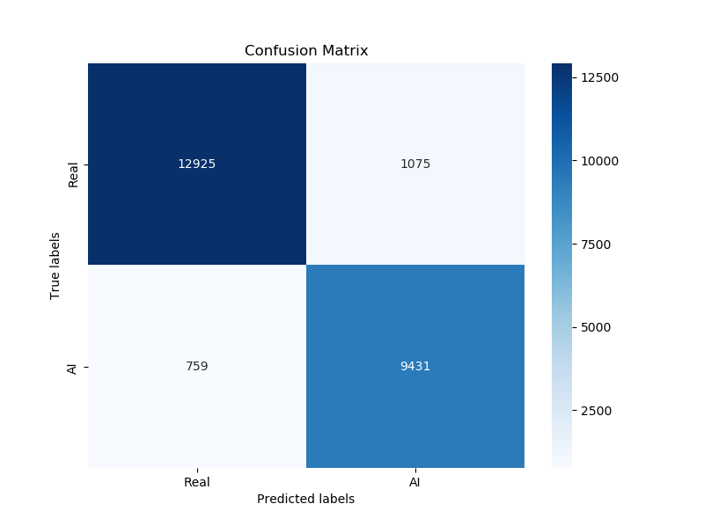
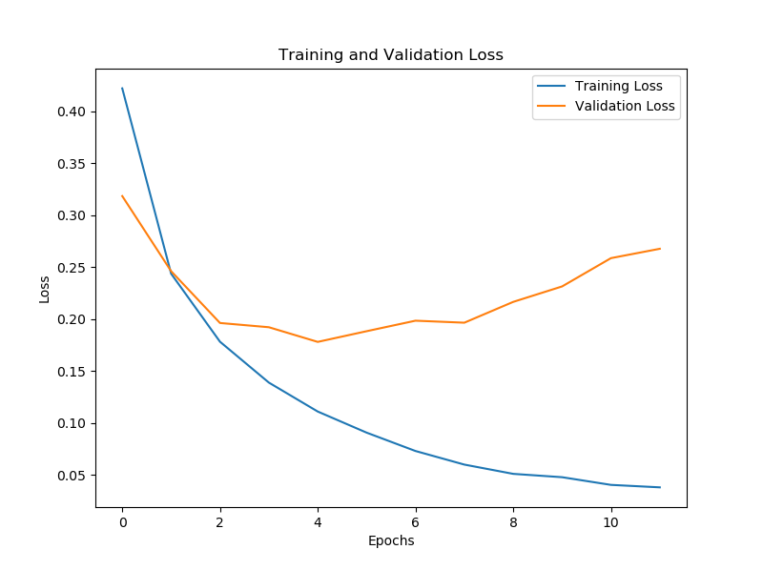
CNN(Bigger data)

Slide 15
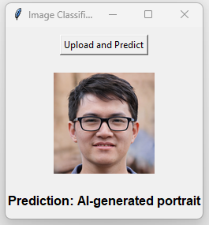
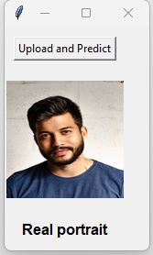

Slide 16
Conclusion
As the prevalence of synthetic images is rising more complex and computational heavy model are required to solve problems as the one in this project. The images will get more realistic but so will the models also be improved.

Slide 17
Thank you

